Slide 1
HELICOPTER SIMULATION
CGV MINI PROJECT
PRACHITI JB - 1RG17CS009
PRAJWAL MANI - 1RG17CS037

Slide 2
AGENDA
Implementation
Testing and Design
Conclusion
Future Enhancements
References
Abstract
Introduction
System Requirements
About the Project
Detailed Design

Slide 3
ABTRACT
This project gives us an insight into the use of OpenGL API for Helicopter Simulation with Python as a supporting language.
The main objective is to allow the user to interact with rich graphic features.
Graphical perspective is rendered from the viewpoint of the user and also it allows the user to strongly control through multiple camera positions.
This implementation provides the application developers with a flexible way to produce quality graphics.
An accurate, effective and real-time display is coded with the help of OpenGL API.

Slide 4
INTRODUCTION
Graphics provides one of the most natural way of communicating within a computer due to highly developed 2D and 3D pattern recognition abilities that allow us to perceive and process pictorial data rapidly and effectively
Since it is largely interactive, the user can control the contents, structure, appearance of the objects and of the displayed images by using input devices such as keyboard, mouse or touchscreen
Interface OpenGL is an API offering various functions to implement primitives, models and images to create, manipulate and render lightning, coloring and viewing the model.
It offers different coordinate systems and frames along with translation, rotation and scaling of objects.
There are 3 main libraries which come into play, Main GL, GLU(OpenGL utility library) and GLUT(OpenGL utility toolkit).

Slide 5
SYSTEM REQUIREMENTS
HARDWARE
Processor – Intel Pentium D CPU with 2.66 GHz
Memory type – RAM Memory of 768MB
Mouse
Keyboard 108 Standard
Monitor Resolution – 800 x 600
SOFTWARE
Operating system - Windows 7 onwards
Programming language version – Python 3.x
Modules – PyOpenGL(V3.1.5), PyOpenGL-accelerate(V3.1.5), Pillow Library(V7.1.2)
Any text editor can be used like Pycharm, VS Code etc

Slide 6
ABOUT THE PROJECT
This project gives us an overview into the coordinate systems of a real time graphics rendered to peform different movements of helicopter depending on the main rotor blade and the tail rotor blade.
It gives a top, front, back and bottom view of the helicopter with respect to camera position which is done by using the field of view(FOV) in degrees.
There is a basic use of classes and objects along with calling the various methods using the global variables declared.

Slide 7
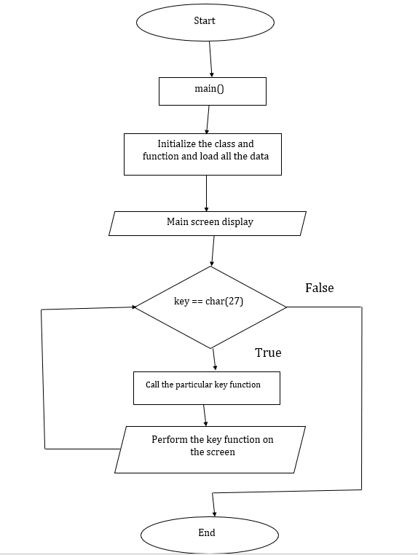
DETAILED DESIGN

Slide 8
IMPLEMENTATION
Python modules used in this project
Numpy
Os
PyOpenGL
PyOpenGL – accelerate
Pillow
Sys
Time
Classes used in this project
Camera class handles camera or viewpoint of the user.
Controller class handles all the controls of the helicopter.
Objloader class loads the objects for different classes and functions.
Scene class handles with the scenario.
Sender class handles the calls and send parameters for the functions.
Simulation class is the main class that calls all other classes and assembles it for smooth output.
Trafo class handles most of the matrix used by other classes.

Slide 9
TESTING AND DESIGN
Serial No. | Action Perfomed | Expected Output | Code Outcome | Pass/Fail
1 | C key is pressed | Change of camera perspective | Camera perspective is changed | Pass
2 | A key is pressed | Left rotation | Left rotation | Pass
3 | D key is pressed | Right rotation | Right rotation | Pass
4 | W key is pressed | Vertically up | Vertically up | Pass
5 | S key is pressed | Vertically down with main rotor blade in stop state | Vertically down with main rotor blade in stop state | Pass
6 | J key is pressed | upslope rolling motion towards left | upslope rolling motion towards left | Pass
7 | L key is pressed | upslope rolling motion towards right | upslope rolling motion towards right | Pass
8 | I key is pressed | upslope rolling motion forwards | upslope rolling motion forwards | Pass
9 | K key is pressed | upslope rolling motion backwards | upslope rolling motion backwards | Pass
10 | Esc key is pressed | Exit | Exit | Pass

Slide 10
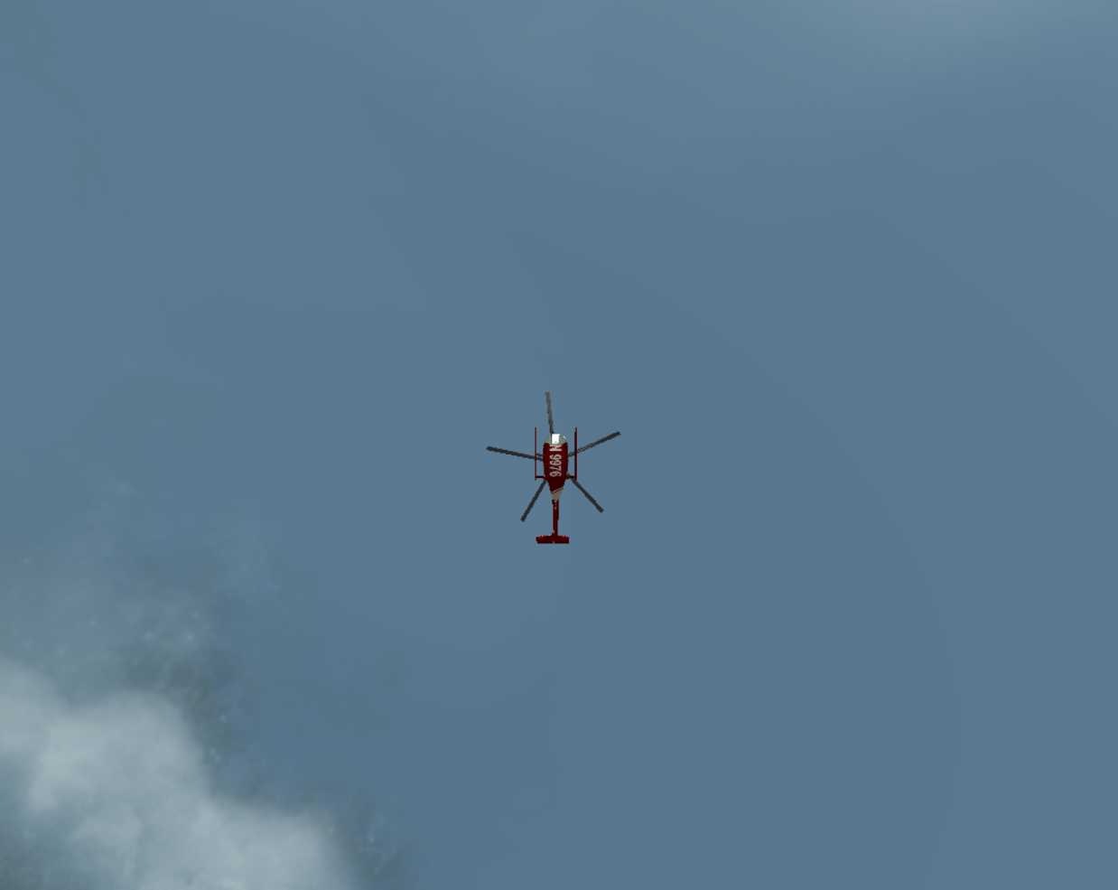
Land view

Slide 11
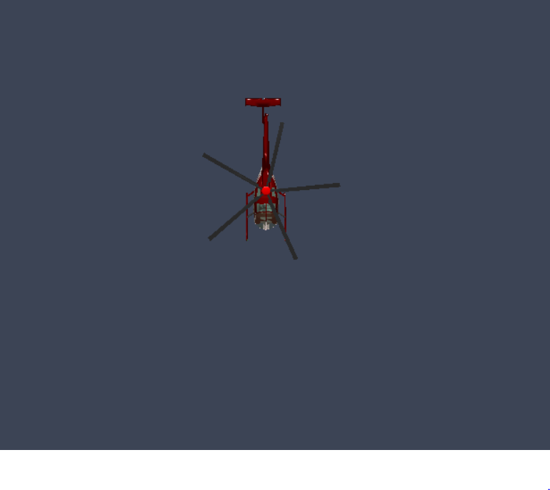
Top view

Slide 12
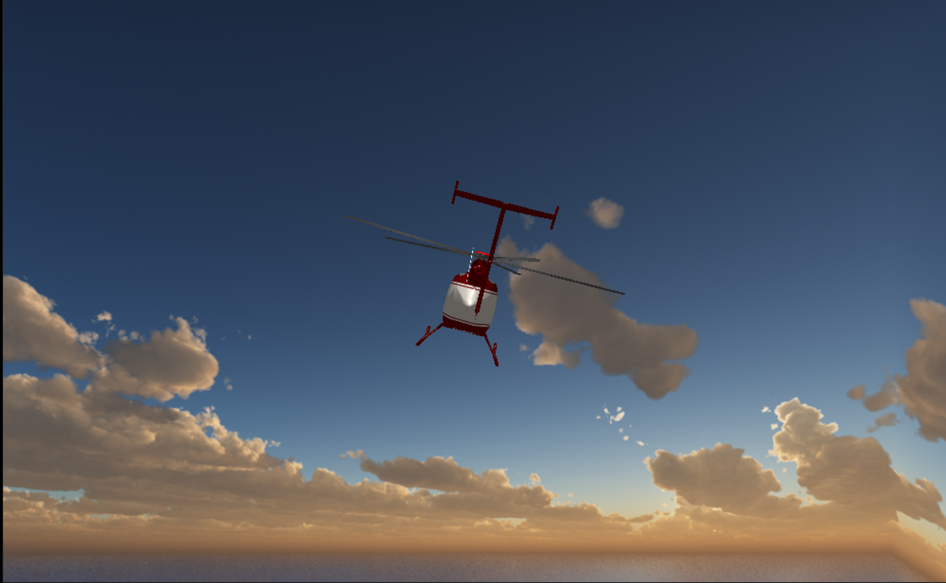
Back view

Slide 13
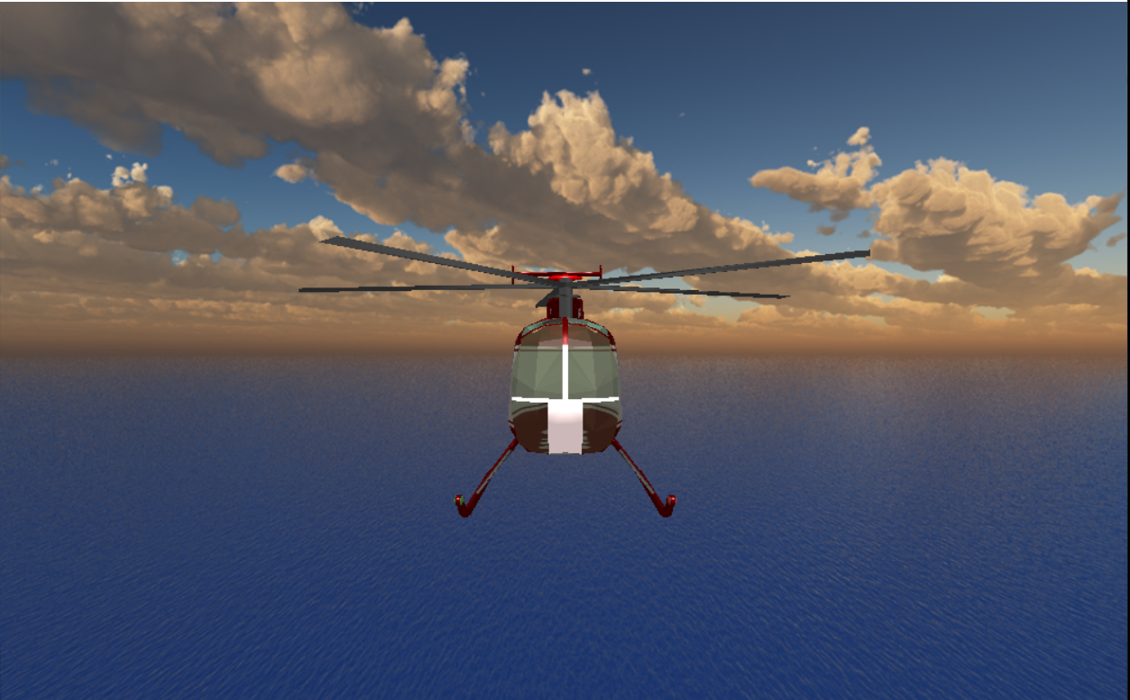
Front view

Slide 14
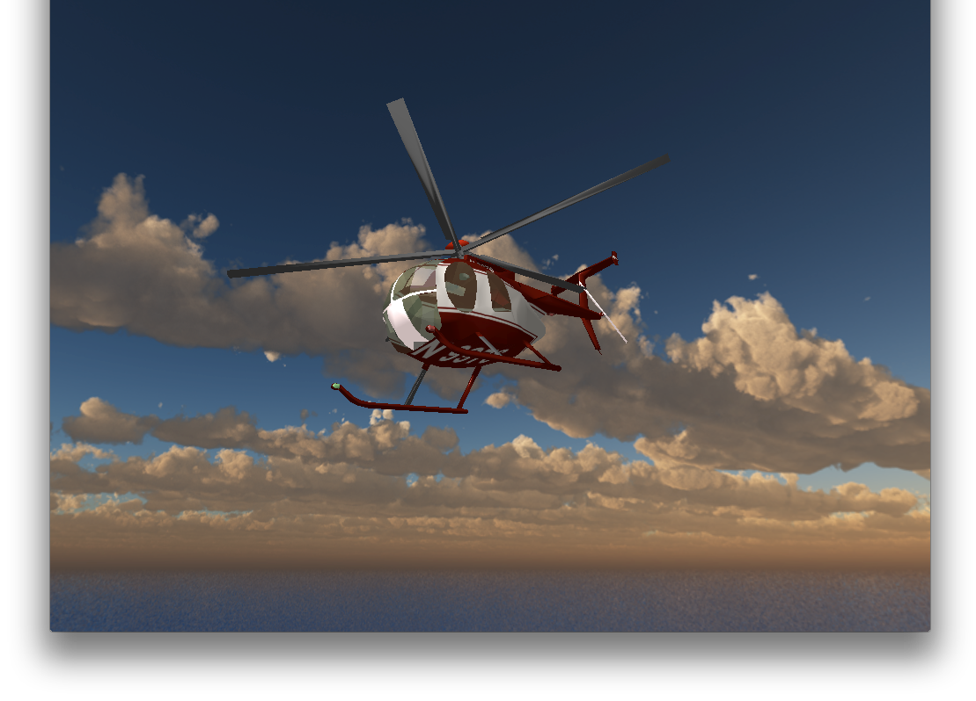
Long view

Slide 15
CONCLUSION
From the graphics which have been rendered by changing the camera perspectives, the user can have an effective and easy access to the controls of the helicopter.
The graphics is visually appealing for the user.
Easy code understandable by the user.

Slide 16
FUTURE ENHANCEMENTS
Adding dynamic color and textures
Have a stable clipping window
Make user controls smoother
Better image rendering
Reducing the complexity of the program

Slide 17
REFERENCES
Donald Hearn & Pauline Baker: Computer Graphics with OpenGL Version, 4thEdition, Pearson Education,2011
Edward Angel: Interactive Computer Graphics- A Top Down approach with OpenGL, 5th edition. Pearson Education, 2008
https://www.opengl.org/
http://pyopengl.sourceforge.net/documentation/index.html
https://pillow.readthedocs.io/en/stable/

Slide 18
Thank you

